Slide 1
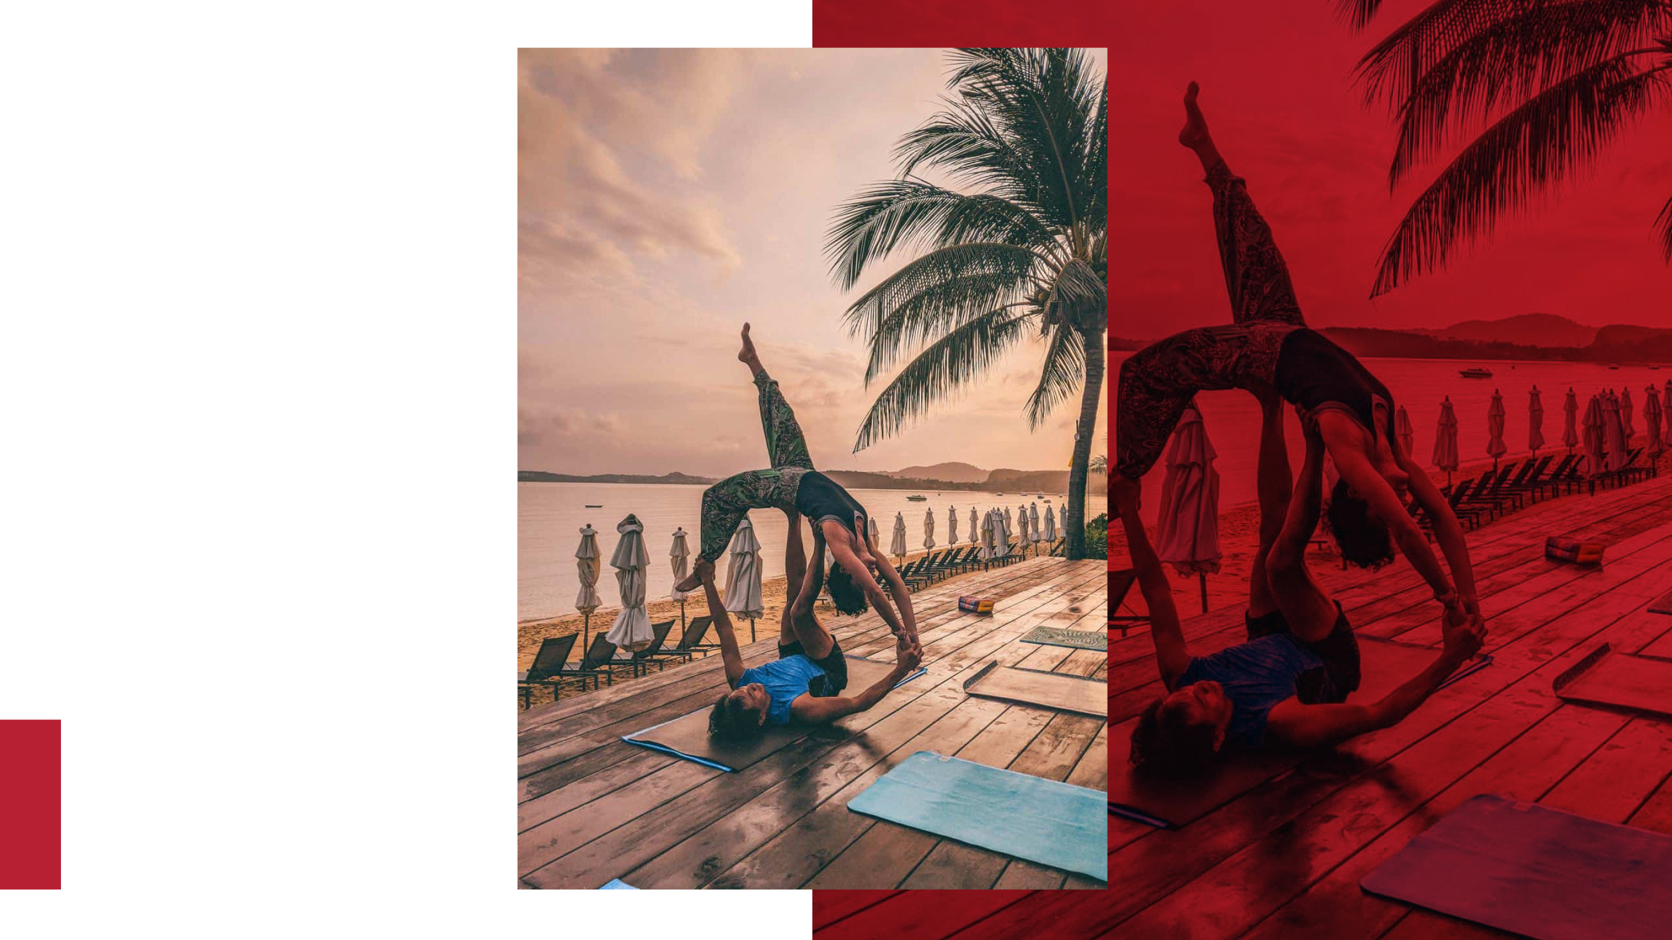



Health & Wellness Signature
Packages in Southeast Asia
• by Red Elephant Reps
SPEAKER:
Paul Tomasch
VP Global Sales, Red Elephant Reps
paul@redelephantreps.com

Slide 2
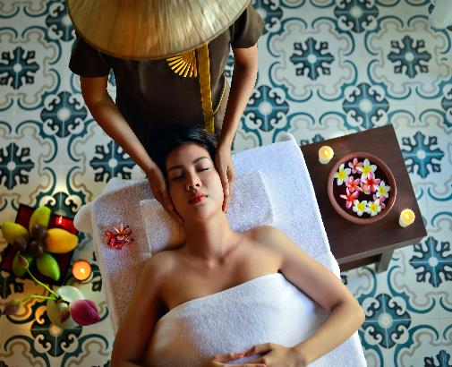
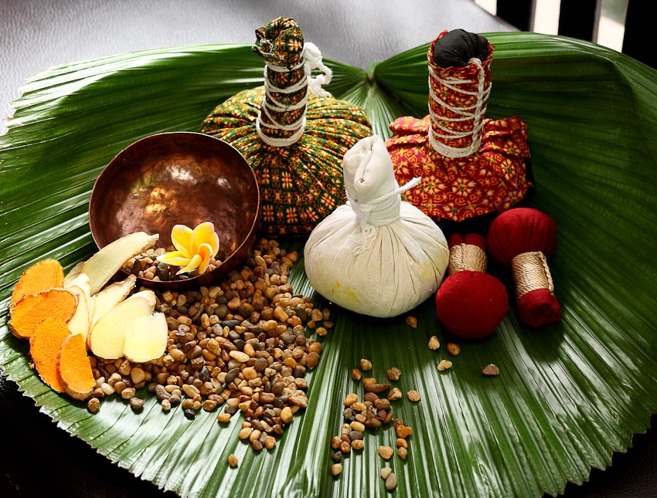
Table of contents
Health & wellness in a disruptive world
Thailand
  Bangkok
    137 Pillars Suites & Residences
    Rembrandt Hotel & Suites
  Chiang Mai
    137 Pillars House Chiang Mai
  Hua Hin
    Aleenta Hua Hin – Pranburi Resort & Spa
  Koh Samui
    SALA Samui Chaweng Beach Resort
  Phuket
    Mangosteen Ayurveda & Wellness Resort
    The Slate
    The Racha
    Aleenta Phuket - Phang Nga Resort & Spa
Cambodia
  Siem Reap
    Park Hyatt Siem Reap
Indonesia
  Bali
    Viceroy Bali
    The Samaya Seminyak Bali

Slide 3
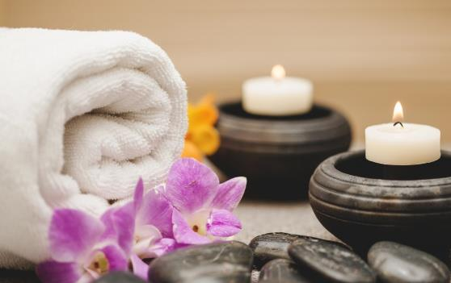

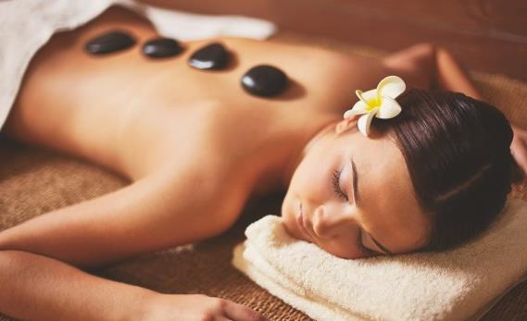
Contents
Health and wellness in a disruptive world
E
ach year, we take time off from our crazy hectic lifestyles in an attempt to relax and recharge. While the regular vacation tends to simply be time off from our daily routine, retreats offer a much more enriching getaway. They provide a serene sanctuary in which to experience a deeper physical and emotional withdrawal from the stresses and strains of everyday life.
From delicious healthy meals, meditation and yoga to healing therapies and counselling, retreats offer a healthy alternative to a regular holiday.
In this webinar we will explore a selection of discerning and unique treatments for those seeking more “me” time – carefully selected by Red Elephant Reps.

Slide 4
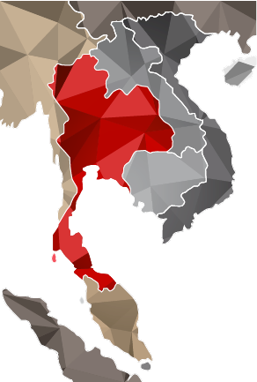
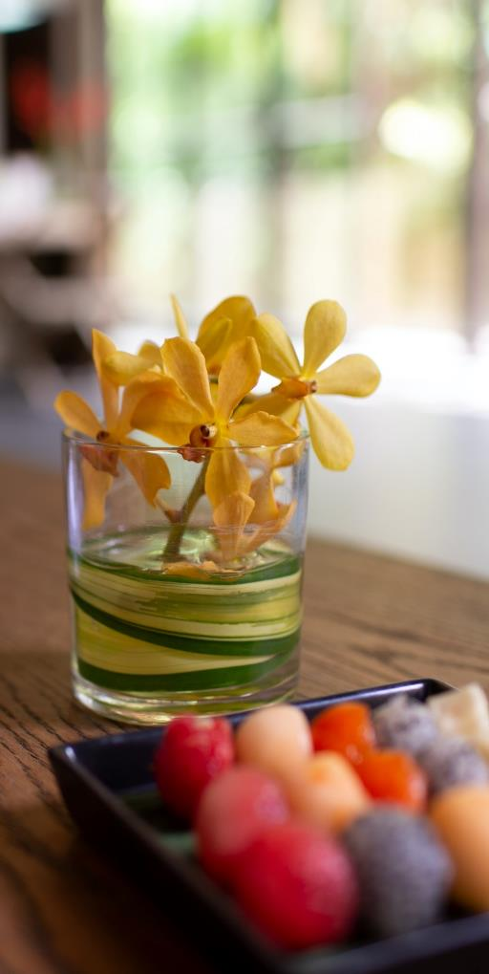
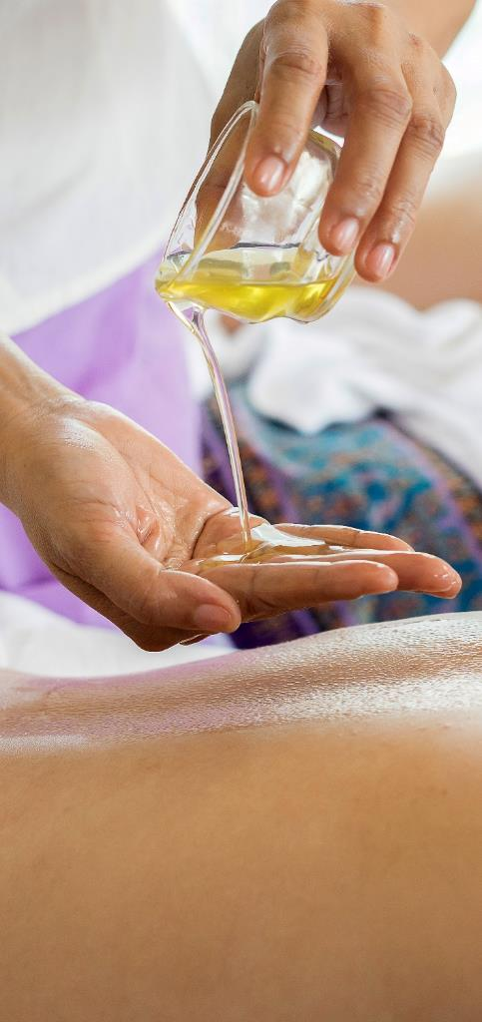
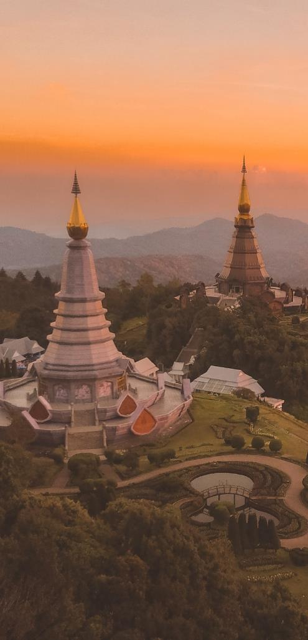


Thailand – The Land of Smiles
CHINA
MYANMAR
VIETNAM
LAOS
137 Pillars House Chiang Mai
THAILAND
Rembrandt Hotel & Suites
137 Pillars Suites & Residences Bangkok
ANDAMAN
SEA
Aleenta Hua Hin
GULF OF
SIAM
Aleenta Phuket
The Slate
Mangosteen Ayurveda & Wellness Resort
The Racha
SOUTH
CHINA SEA
MALAYSIA
INDONESIA
SINGAPORE

Slide 5
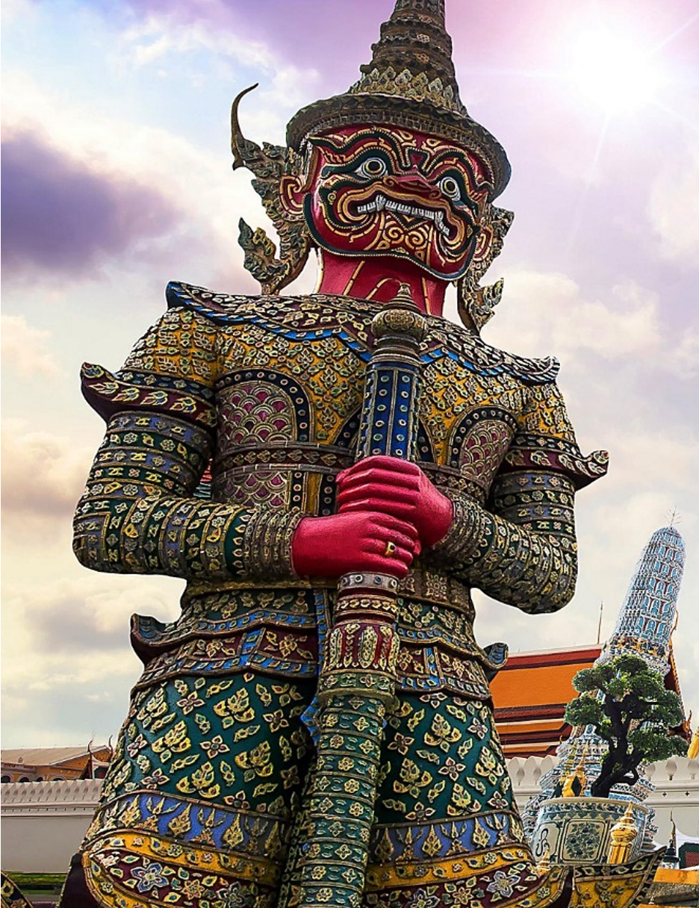
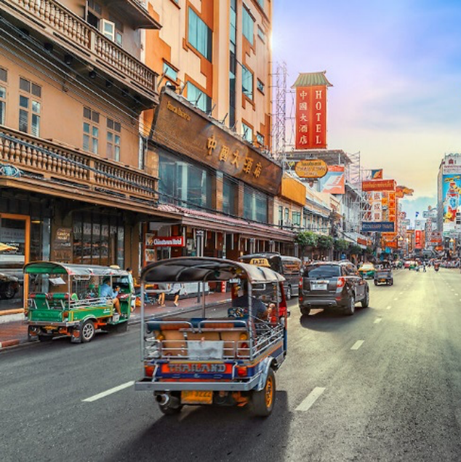
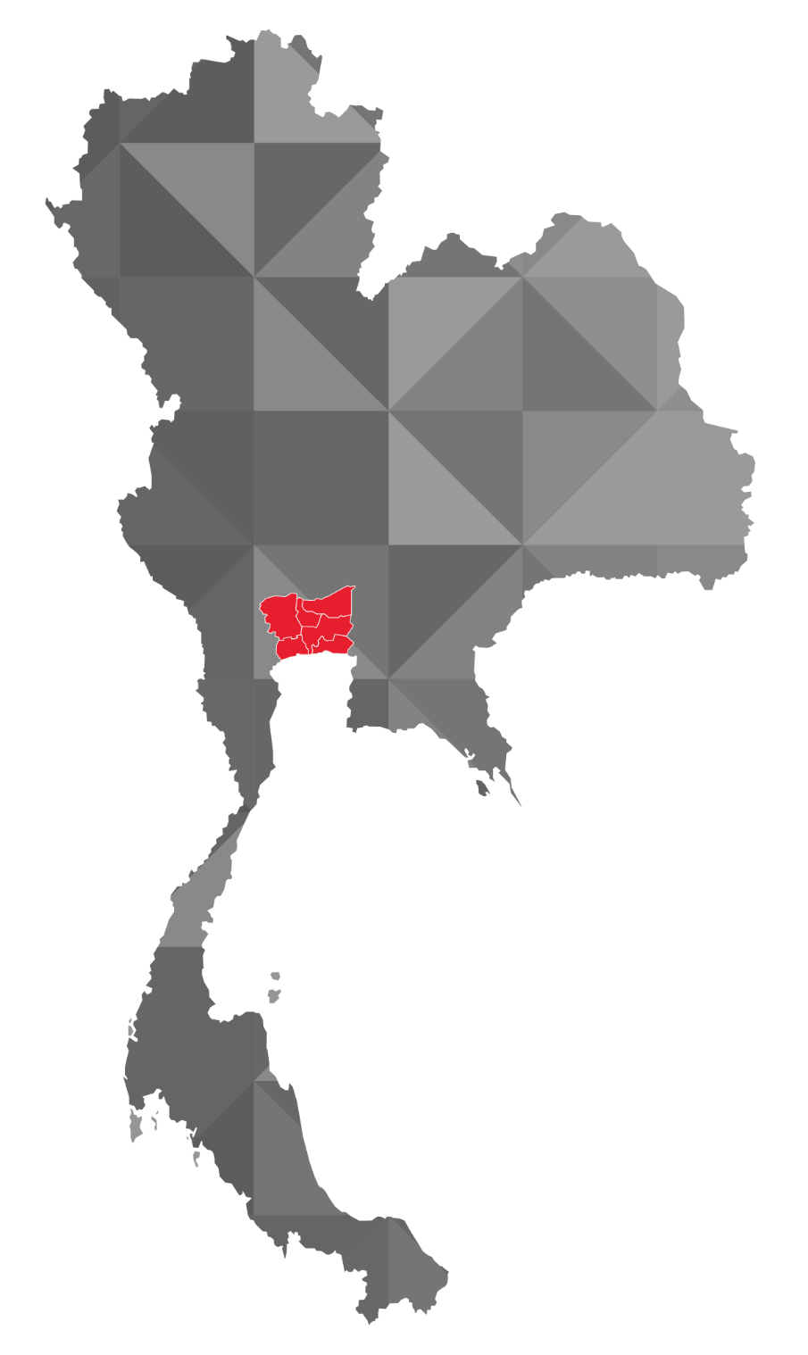
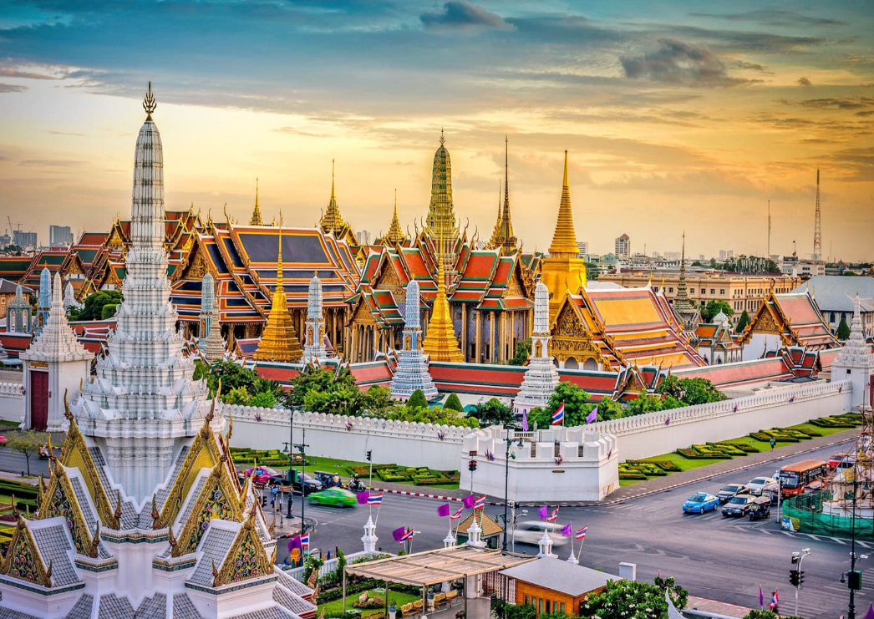
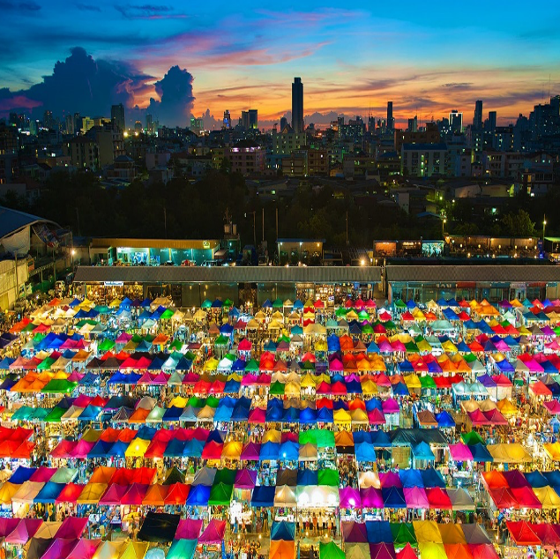
Bangkok – Serene And Vibrant
Chiang Rai
Chiang Mai
Bangkok
Koh Samui
Krabi
Phuket

Slide 6
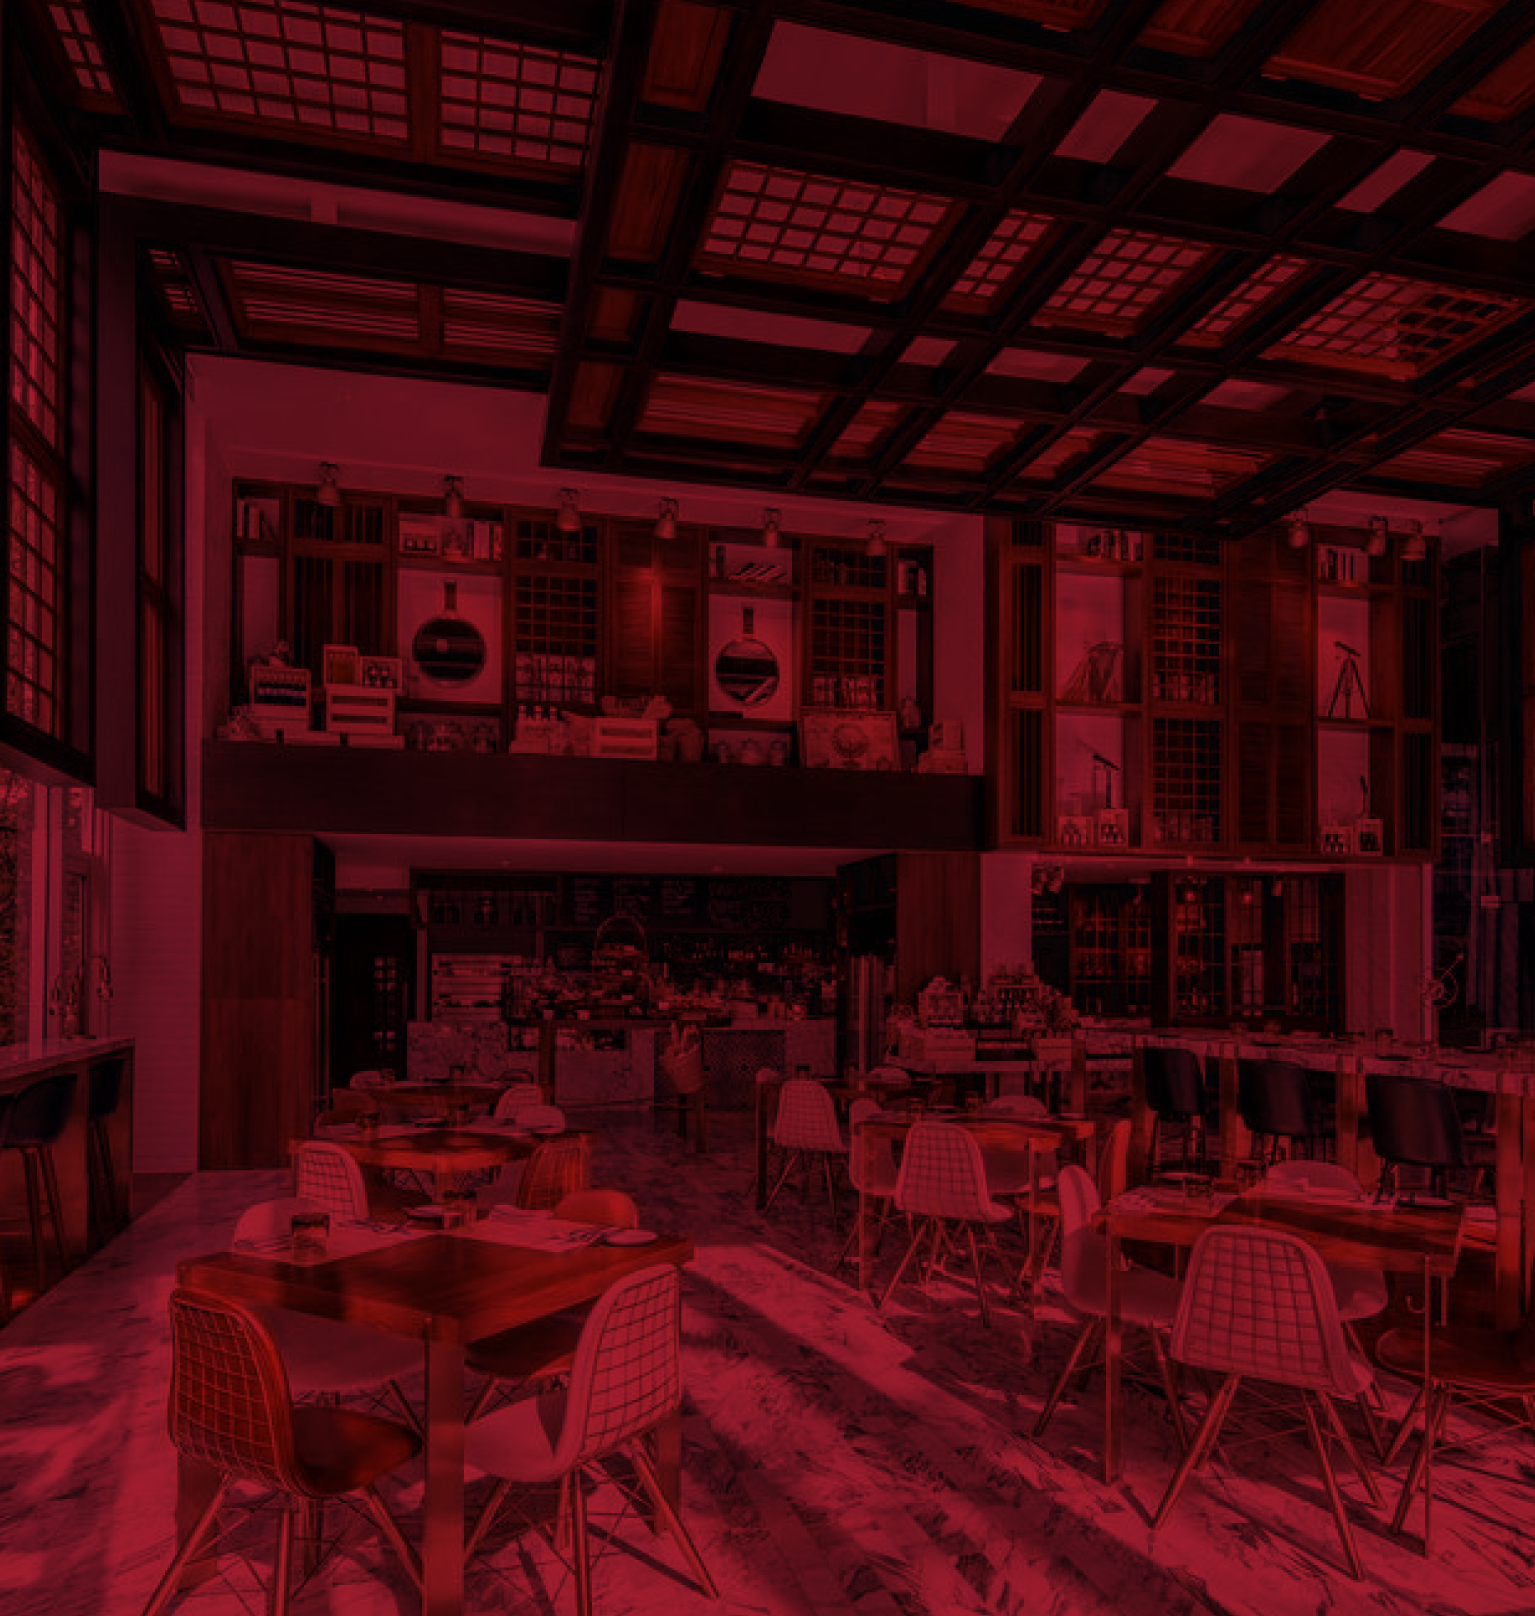
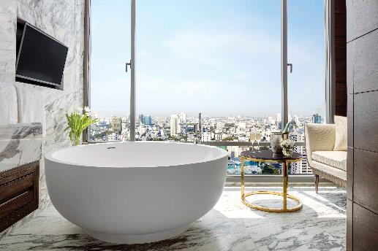
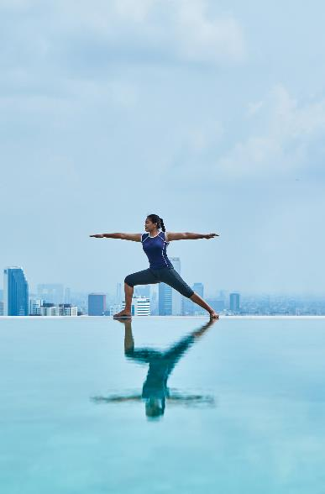

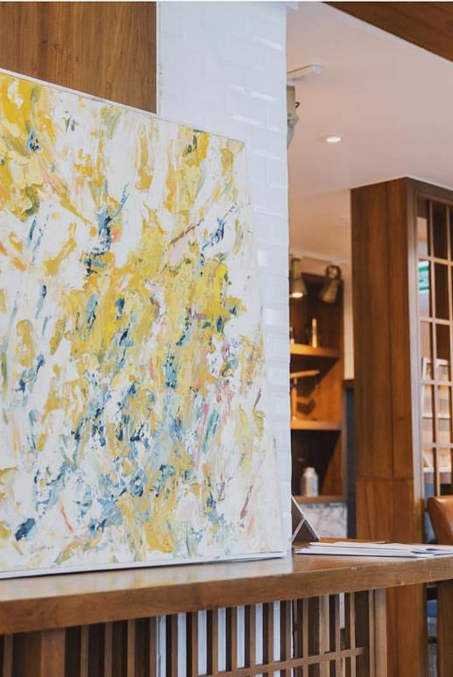
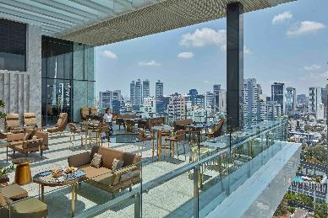
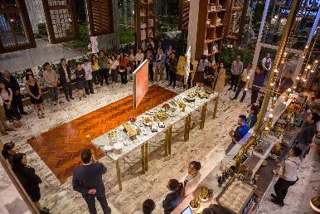
137 PILLARS SUITES & RESIDENCES
Bangkok — Thailand
Most A-List Suite Experience, Small Luxury Hotels Awards 2017
Butler service and personal mobile phone with 4G connection
Maxi bars with private wine cellars in all suites
Louie and Jack, the 137 Pillars London cabs offer complimentary transfers to the skytrain and nearby shopping malls
Personal shopper service, private barber and hairstylist
Privately curated Bangkok art tour

Slide 7
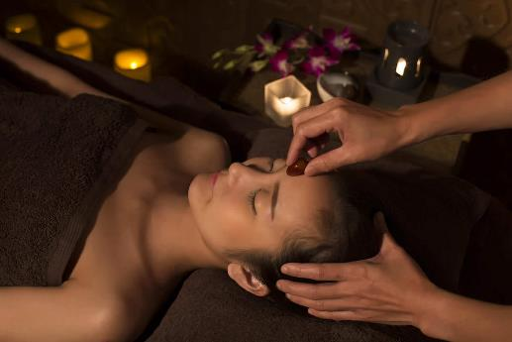
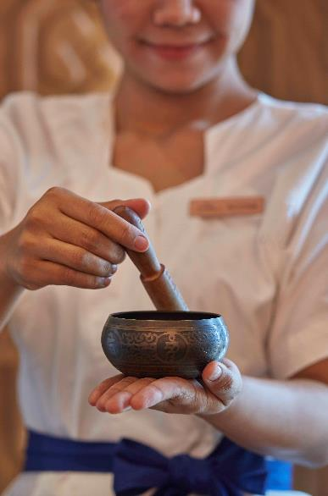
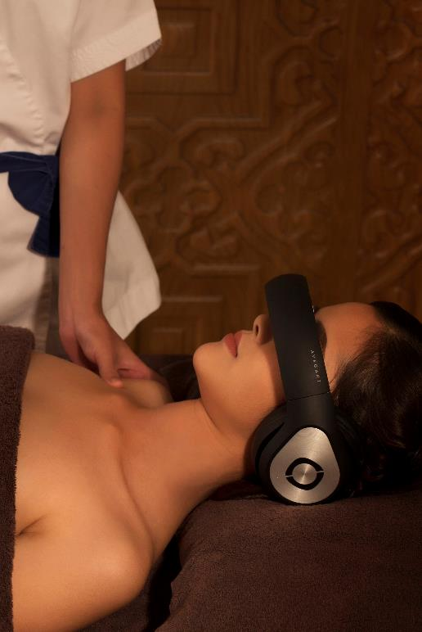
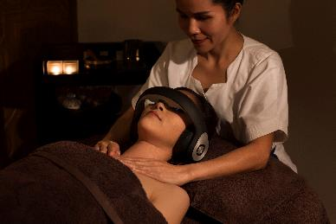
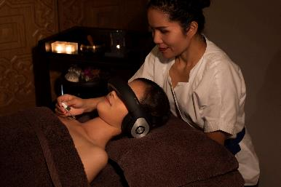
137 PILLARS SUITES & RESIDENCES
SLEEP BY DESIGN THERAPY
Overview:
Exclusive to 137 Pillars Hotels & Resorts’ Wellness Programme, the Sleep by Design therapy programme is a deeply restorative, soothing and relaxing treatment that improves quality of sleep and recovery through a combination of traditional holistic elements, combined with the latest technology.
Inclusions:
Pre-warmed towels
Oil aroma burner
Binaural beats (sound wave therapy)
Eye mask
Floral foot cleansing ritual
Reiki treatment
Full body massage therapy
Pricing:
Sleep by Design Therapy is priced at THB 4,200++ per person.

Slide 8
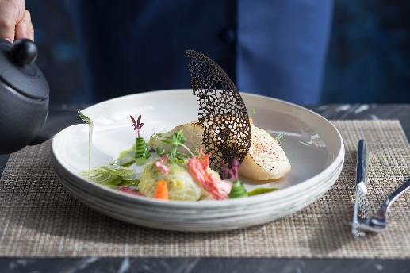
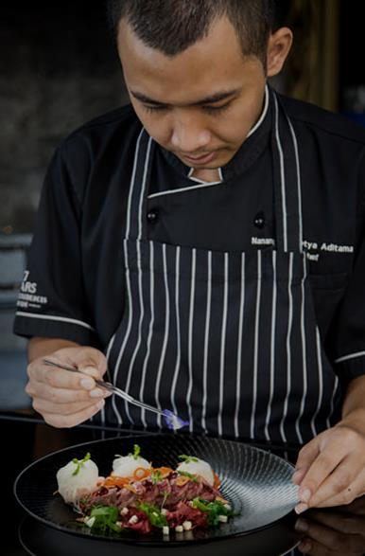

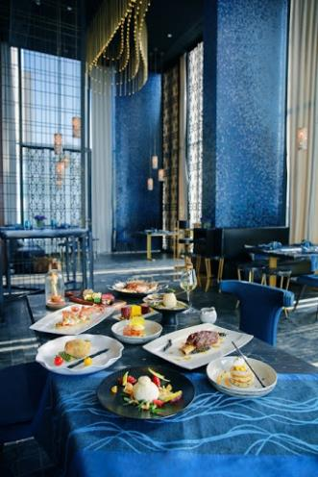
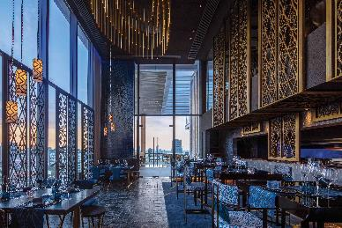
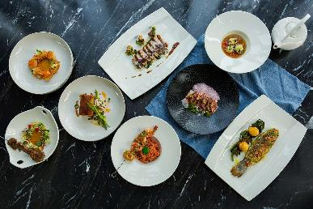
WELLNESS CUISINE
Overview:
The team of talented chefs at 137 Pillars Suites & Residences Bangkok has created a menu of sumptuous dishes that perfectly match the therapies being offered during the hotel’s Season of Wellness, based on different food groups.
Inclusions:
Sustainable, organic and seasonal ingredients from Thailand and around the world
The open kitchen and a wellness menu curated by award winning Chef Nanang
The spacious Nimitr Terrace with its breathtaking city views
Pricing:
A la carte menu available at Nimitr Restaurant for both lunch and dinner.

Slide 9
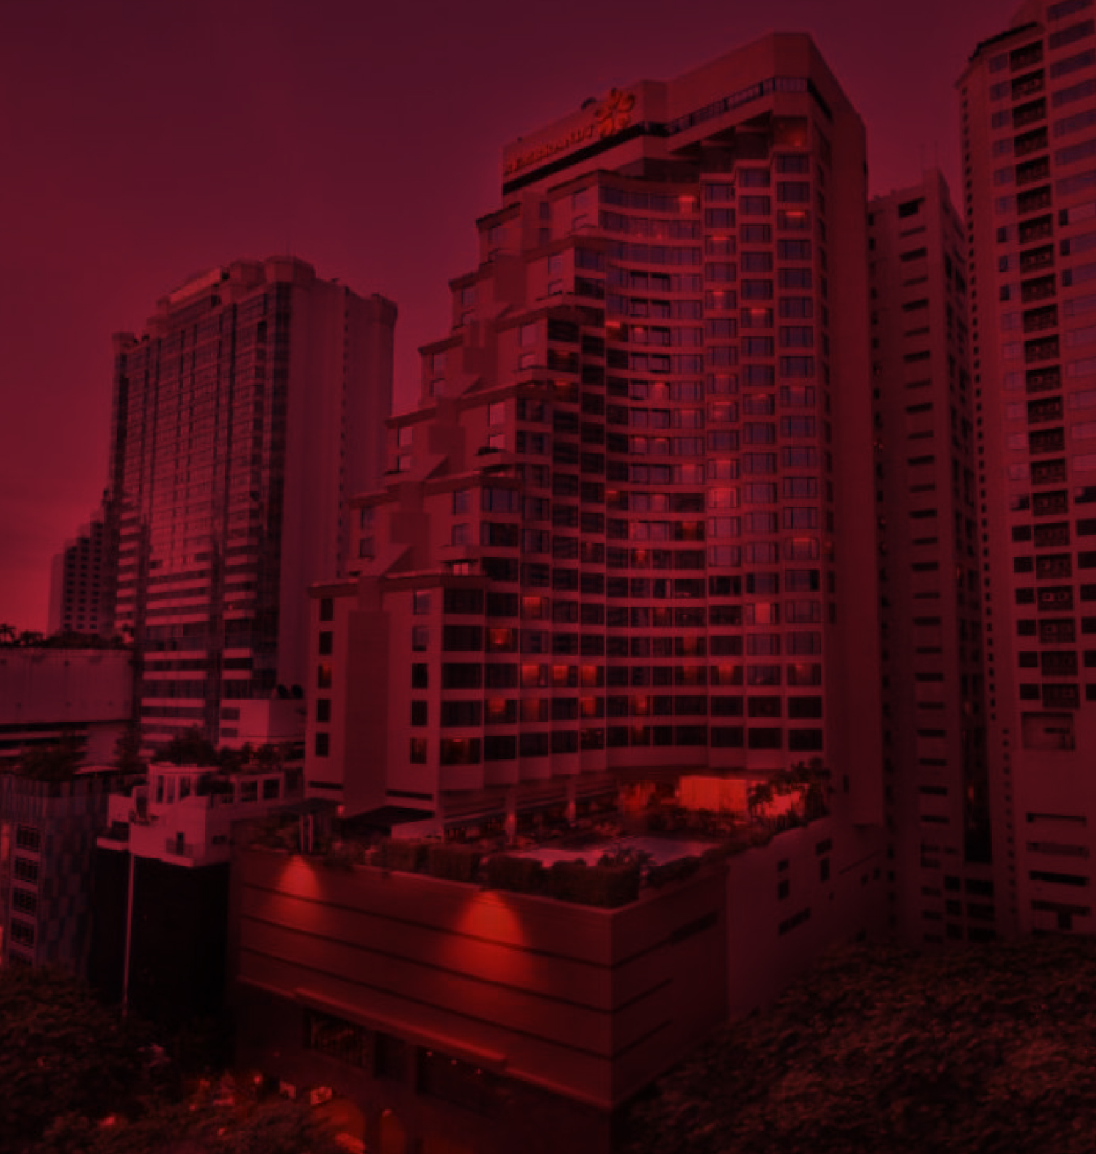
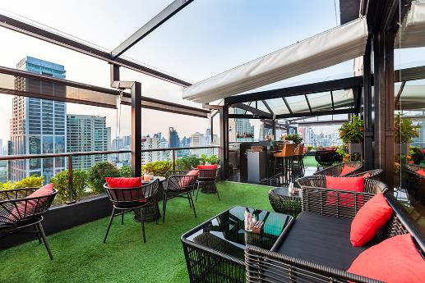
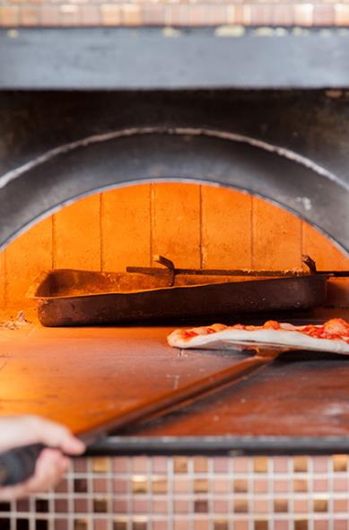
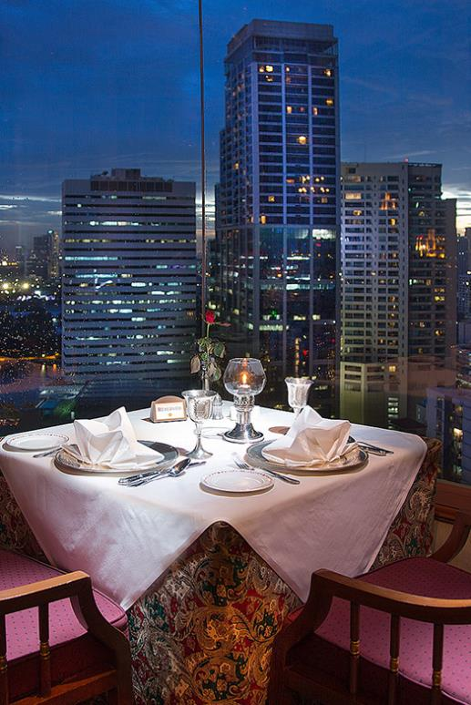
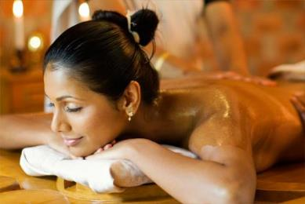
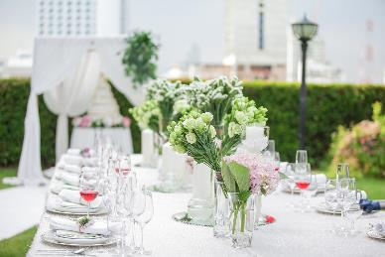
REMBRANDT HOTEL & SUITES
Bangkok — Thailand
Located in the heart of Bangkok in a quiet location just a few minutes walk from the popular Sukhumvit Road
Within walking distance to the Skytrain, Metro and major shopping malls
Multi award-winning restaurants and a rooftop bar
Suitable for all types of travellers including business, families, honeymooners and solo-travellers
Suvarnaveda SPA with Ayurvedic treatments and a health counsellor

Slide 10
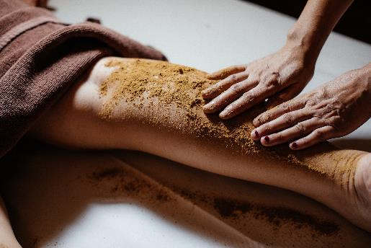
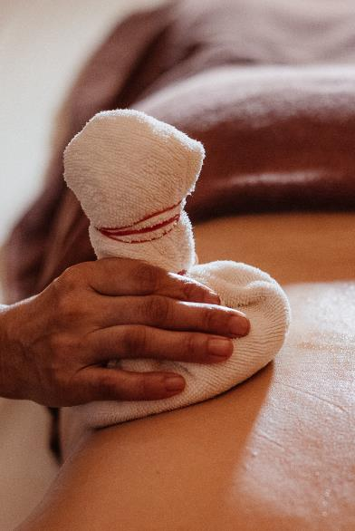
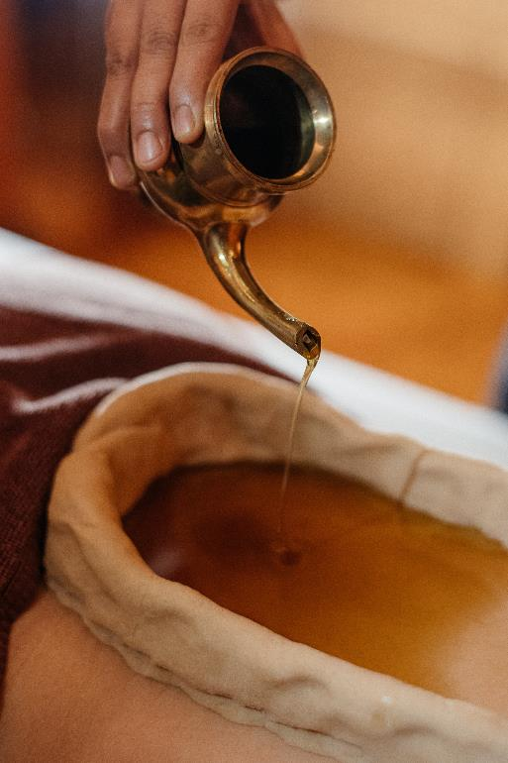
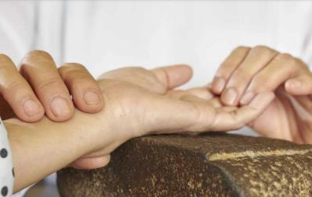
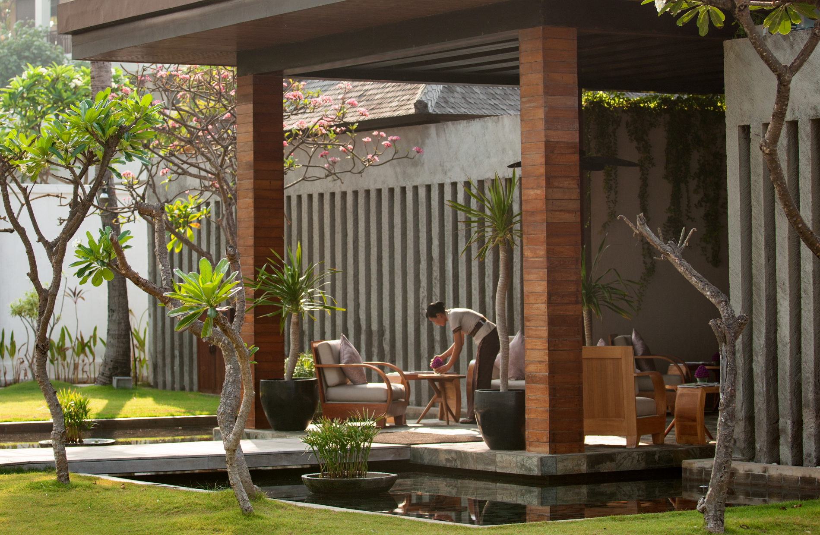
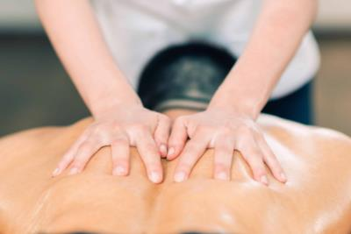
PANCHAKARAMA
Overview:
Panchakarama is a group of therapies that work together to purify the body and thus reduce the development of disease and aging. This Invigorating and energising treatment can last from 1 to 3 weeks, depending on the needs of the client. It is beneficial for chronic pain, arthritis, allergies, asthma, auto immune disorders, obesity, infertility, diabetes, hypertension, insomnia, skin and digestive disorders. The therapies detoxify and enhance the power of digestion and metabolism.
Inclusions:
Accommodation for the full duration of the treatment
Personalised detoxifying Panchakarma treatment, depending on your needs
Detoxification through a personalised Ayurvedic diet including appetising and digestive herbs
Therapies for loosening and removing the toxins
NAVARAKIZHI
Overview:
This is one of the most popular therapies used for the purpose of rejuvenation of the body. This type of massage uses a special type of medicated rice. The therapy endows several benefits to a healthy person as well as to the ill. “Navarakizhi” improves complexion of the skin, promote digestion and restores vigour.

Slide 11
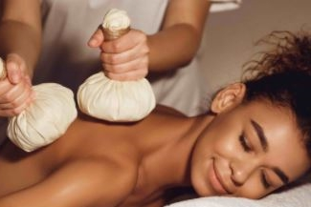
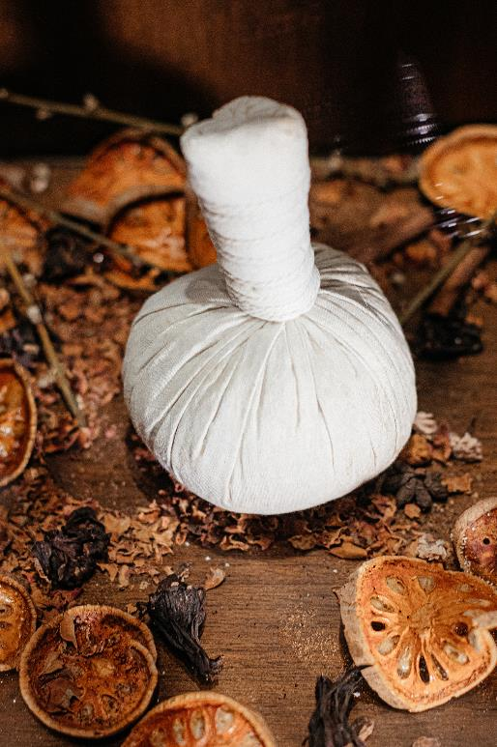
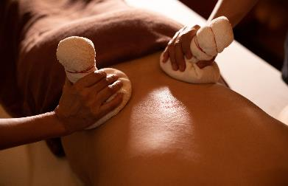
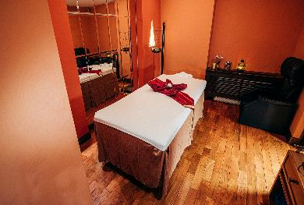
NAVARAKIZHI
Overview:
This is one of the most popular therapies used for the purpose of rejuvenation of the body. This type of massage uses a special type of medicated rice. The therapy endows several benefits to a healthy person as well as to the ill. “Navarakizhi” improves complexion of the skin, promote digestion and restores vigour.
Pricing: 2000 THB for 60 min

Slide 12
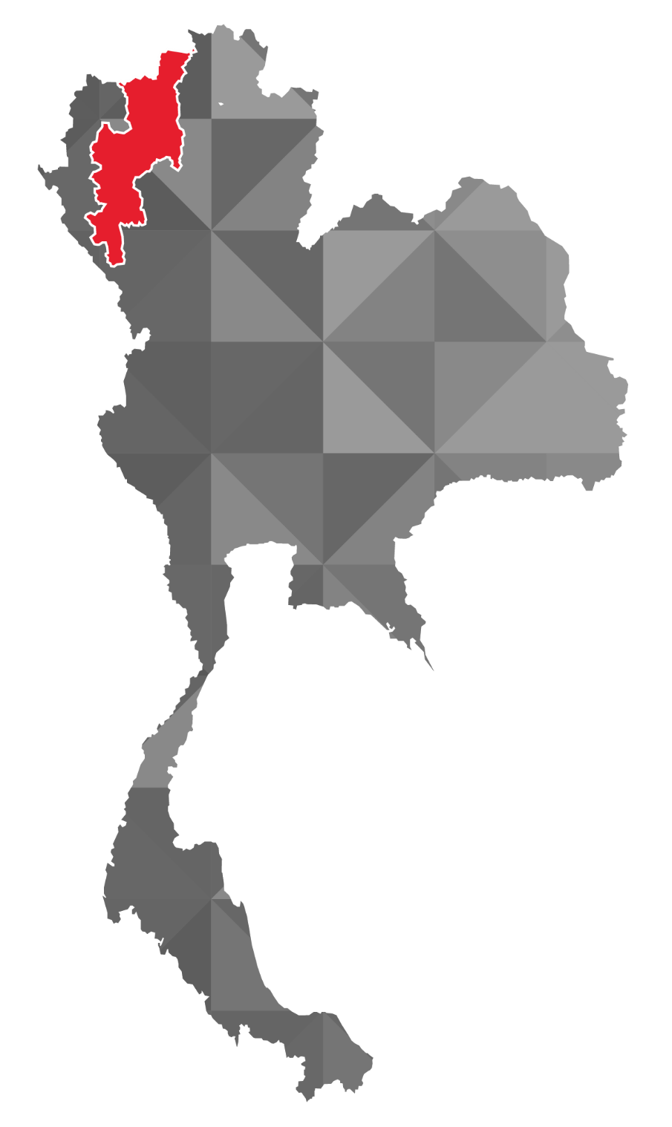
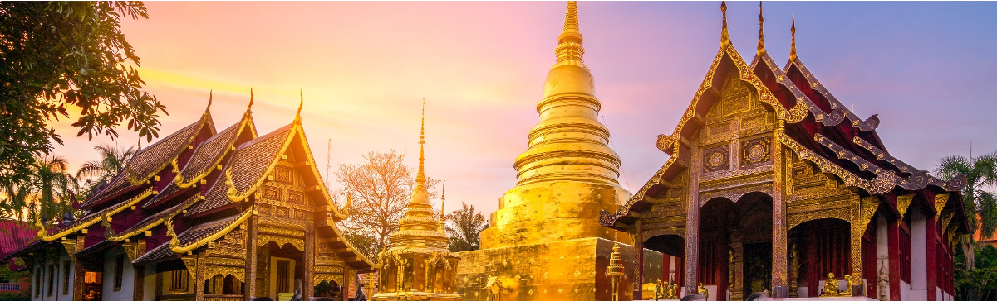
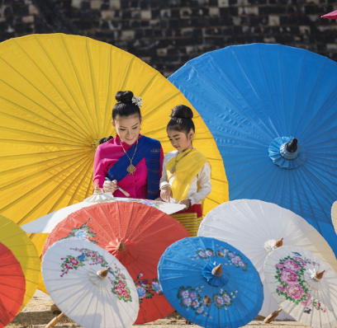
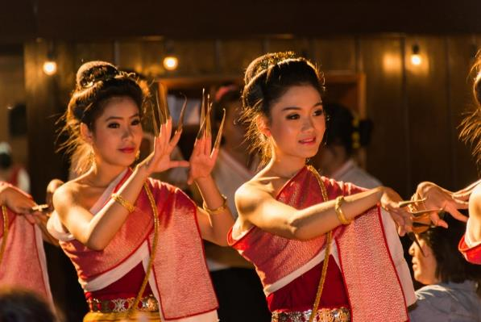

Chiang Mai – The Rose Of The North
Chiang Rai
Chiang Mai
Bangkok
Koh Samui
Krabi
Phuket

Slide 13






137 PILLARS HOUSE CHIANG MAI
Chiang Mai — Thailand
The former headquarters of the Borneo Timber Company dating back to 1889
An intimate boutique hotel that combines old world elegance with modern facilities
Lush landscaping and majestic trees create a tranquil rainforest environment
Peaceful location, yet still close to the old city
Dedicated Butler for each suite

Slide 14





TRADITIONAL THAI MASSAGE
Overview:
Ancient healing art of old Siam, using pressure points and palm pressure combined with meridian line stretches to improve mobility, ease stress and strain, and increase circulation and range of movement. Applied through clothes without the use of oils.
Pricing:
60 / 90 minutes THB 2,500++ / THB 3,500++ per person

Slide 15





AQUA THERMA MASSAGE
Overview:
Ideal for warming and increasing poor circulation and peripheral areas of the body, increasing efficiency in the lymphatic and detoxification processes. It is highly recommended for couples. Women over 4 months pregnant can benefit from this treatment as well, since the whole massage is applied whilst the recipient lays face up, to access those aching lower back muscles that 'mums to be' so often experience. A rare treat indeed.
Pricing:
60 minutes THB 3,500++ per person

Slide 16





Hua Hin – Royal Seaside
Chiang Rai
Chiang Mai
Bangkok
Hua Hin
Pranburi
Koh Samui
Krabi
Phuket

Slide 17






ALEENTA HUA HIN - PRANBURI RESORT & SPA
Pranburi — Thailand
Most residences have a private pool
Each suite is located within mere footsteps of the beach
An onsite wedding planner
A new ‘Epicurean Spa’ with deep healing therapies
All spa inclusive option

Slide 18





FAMILY FUN DIGITAL DETOX PACKAGE
Overview:
Break free of your devices and go on a family digital detox holiday. By switching off your digital gadgets it allows you to switch off from life completely - the best way to de-stress and reconnect with yourself and your loved ones without any interference.
Inclusions:
Organic farm excursion and pick-your-own-eggs for your breakfast
Beach kite flying experience
Clay dolls painting
Yoga class for kids from 6 to 12 years old
Batik crafting
Cupcake decoration class
Pizza-making class
Seashell picking on the beach with our resort guide
Visitation to nearby attractions such as national park and navy base
Herb press crafting
Aleenta signature cooking class
Pricing:
The Package is available for just THB 500 per person per night when guests book a minimum of 3 nights.

Slide 19





AYURAH WELLNESS STRESS & BURNOUT PREVENTION RETREAT 5 DAYS / 4 NIGHTS
Overview:
Spend five days at our Hua Hin Resort to regain your vitality and restore your energy levels. Our balancing wellness retreats are carefully designed to create positive changes, reduce and manage your stress levels.
Inclusions:
Accommodation in an Ocean View Residence
Welcome drinks & introductions
Personal Wellness Assessment to customise your yoga and healing treatments
Daily 60 minutes customised yoga and meditation (morning and evening)
30 minutes deep yogic relaxation for improved digestion
60 minutes yogic detox Kriya and pranayamas (breathing techniques)
90 minutes therapeutic massage treatment
Visit to Aleenta organic garden, and healthy cooking session
Full board (three daily meals): Delicious and balancing Thai-Fusion vegetarian meals developed by our creative chef
Healthy juices/smoothies, water and infusions
Welcome gift
Pricing:
Single occupancy: THB 34,000++
Double occupancy: THB 27,000++ per person

Slide 20





Koh Samui - Enchanting island retreat
Chiang Rai
Chiang Mai
Bangkok
Krabi
Phuket

Slide 21






SALA SAMUI CHAWENG BEACH RESORT
Koh Samui — Thailand
New resort, only opened in 2018
Good location in the main resort of Chaweng
Spacious rooms with unique layout
Innovative dining options

Slide 22





SALA Spa Retreat Package
Overview:
Treat yourself to a blissful break on the pure shores of Koh Samui with our soothing spa retreat package. Guests will enjoy three days of pampering at the SALA spa in Chaweng. Minimum stay of 3 nights.
Inclusions:
Daily breakfast for 2
Transfer from/to Samui International Airport or any other point on Koh Samui
Daily spa treatments:
  1st day: 2-hour “The Choice is Yours” package (30-minute body scrub and 90-minute massage for two)
  2nd day: 2-hour Aromatic Swedish massage and Thai Herbal Facial (60 minutes each)
  3rd day: 90-minute Soothing Aroma Massage
Healthy drinks will be served at the end of the spa treatments.
A complimentary healthy lunch for two.
Complimentary late check out at 4pm, subject to availability.
Pricing:
THB 16,200/2 persons with a minimum stay of 3 nights, rates are subject to 7% service charge and government tax

Slide 23





MOTHER-TO-BE
Overview:
Designed specifically for mothers-to-be, this massage promotes relaxation, increases circulation and provides comfort during this wondrous time of change. The treatment helps to relieve tension and alleviate swelling in the hands or feet. Your comfort and safety are assured with supportive pillows and sweet almond oil.
Pricing:
60min treatment for THB 2,800 or 90 mins treatment for THB 3,200

Slide 24





Phuket – Pearl of The Andaman
Chiang Rai
Chiang Mai
Bangkok
Krabi
Koh Samui
Phuket

Slide 25






MANGOSTEEN AYURVEDA & WELLNESS RESORT
Phuket — Thailand
Authentic Ayurveda treatments with in-house certified Ayurveda doctor
Choice of yoga and wellness retreats
Healthy Ayurveda food menu offered as part of the retreats
Unique design by Australian designer - John Underwood
Underground wine cellar with extensive choice of wines.

Slide 26





AYURVEDA HEALTH & WELL-BEING PACKAGES
Overview:
The Mangosteen Ayurveda Resort offers a variety of health packages, which can be further individualised.
Benefits, Terms and Conditions:
Free upgrade to Royal Balcony Villa.
Free airport transfer, two ways.
Guaranteed priority booking, means we will have availability for you when you need it.
Validity: 3 years, choose any travel dates within 3 years from date of purchase. No blackout periods.
Non-refundable but travel schedules can be amended free of charge, as often as necessary.
Transferable: As a present for family or friends.

Slide 27





ROYAL SHIRODHARA
Overview:
Experience a complete state of mindfulness and bliss with this 90 minutes of gentle flow of medicaments over the Third Eye Chakra. The treatment helps to reduce stress and enhances cellular intelligence and immunity. This involves the continuous pouring of oils, milk, buttermilk or ghee over the forehead and scalp. Oil stroking the ‘third eye’ has a balancing effect on the deepest recesses of the brain. The treatment helps with anxiety and hypertension, relaxes the nervous system, and treats neurological disorders.
Pricing: 5000 THB for 85 min

Slide 28





BURNOUT-PREVENTION RETREAT
7 NIGHTS / 8 DAYS
Overview:
The Mangosteen Ayurveda & Wellness Resort is a perfect place to join a Burnout Prevention programme, as it offers comfortable accommodation, a calm and peaceful atmosphere, and dedicated staff that regard your tranquility to be of the upmost of importance.
Inclusions:
360 minutes spa treatments
720 minutes yoga & meditation
60 minutes cardio or zumba
Magnesium Float 60 minutes
Healthy homemade welcome drink, cold towel, and homemade local sweets upon arrival
2 daily yoga sessions (60 minutes each) at Prana Yoga Sala with one of our expert teachers
24 hours use of salt-water treated swimming pool
24 hours use of fitness centre
Free use of Himalayan Rock Salt Infrared Sauna (during public hours)
Pricing: NO PRICING YET

Slide 29






THE SLATE
Phuket — Thailand
Located by a protected national park with a calm shallow lagoon (safe swimming, no jet skis)
Private Pool Villas up to 2500sqm with butler service
Family Suites with connecting rooms
Uniquely designed Spa

Slide 30





HEALTH BY DESIGN
Overview:
Revitalise with our Premium Vitamin Drip supervised by a certified physician from the American Board of Anti-Aging & Regenerative Medicine at KRU Precision Wellness clinic within the resort.
Inclusions:
The Slate signature welcome drink
One-time Vitamin Drip for 1 person with a 30 minute massage service for foot or neck and shoulder during the session
One-time 60 minute massage for 1 person at Coqoon Spa
Complimentary basic yoga and pilates session (24 hours advance booking is required)
Complimentary one time lunch for 2 people at Underground Café
Complimentary lone time dinner for 2 at Tin Mine or Black Ginger: recommended by Michelin Guide
Complimentary stay for 2 children under 7 years old inclusive of daily breakfast, one time lunch at Underground Café and one time dinner at Tin Mine or Black Ginger, from Little Miners menu (for D-Buk Family Suite only)
One day free car rental
Pricing:
2 nights in a Pearl Bed Suite – THB 12,600++ per person

Slide 31





PURPLE FRANGIPANI WRAP
Overview:
Combining the elements of purple frangipani for firming and softening, rice bran oil for its moisturising attributes, and rose floral water for its antibacterial properties. Emerge feeling silky smooth.
Pricing:
60 mins THB 2,700++

Slide 32






THE RACHA
Koh Racha Yai, Phuket — Thailand
An award-winning SLH resort (2019 World Luxury Hotel Awards)
Environment Sustainability: ‘Silver Certification’ from EarthCheck and ‘Gold Level’ Green Hotel Award from Thailand’s Ministry of Natural Resources & Environment
Set on the beautiful Batok Bay on the island of Racha Yai
Three ozonated swimming pools with underwater music and hydro jets
Superb snorkelling and diving destination
Fully equipped five-star Racha Dive Center

Slide 33





WHITE MUD BODY MASK - 55 MINS
Overview:
White mud contains gypsum minerals that act both as a cleanser and ‘blanket’ to tighten the pores of the skin. This super-rich combination of marine minerals and vitamins help eliminate water retention whilst improving circulation in the body. A Thai beauty secret for maintaining a smooth silhouette.
Pricing:
No Price Yet

Slide 34





PERFECT SPA FOR MEN - 2 HOURS
Overview:
Relax your muscles and melt away tension in a steam bath. Feel your skin renewed with a herbal body scrub followed by a deep tissue full body Sanctuary Sports massage.
Pricing:
No Price Yet

Slide 35






ALEENTA PHUKET PHANG NGA RESORT & SPA
Phang Nga — Thailand
Short distance away from the Blue Canyon Golf Course and Phang Nga Bay
Spacious rooms starting from 80sqm
Resort packages and special offers for honeymooners, adventure and families
All spa inclusive option

Slide 36





TIBETAN SINGING BOWL THERAPY
Overview:
Sound therapy with Tibetan singing bowls is an ancient form of regeneration. The first bowls were made from an alloy of various metals and were being used over 6000 years ago in the Far East. The sound of the Tibetan singing bowls and the gongs harmonise and allow deep relaxation of both sides of the brain. It stimulates stress relief on all levels and the elimination of toxins from the body. After sound therapy emotions are calm and the mind clearer, as the sound vibrations have an effect on the body after the singing bowls have been played on it.
Pricing:
THB 1,500 per person per session - advanced booking required

Slide 37





LINDA MEREDITH COLLAGEN FACIAL MASKS
Overview:
Linda Meredith has worked in the beauty industry for over 40 years. Throughout that time she has noticed a dramatic change in how our skin is evolving. Researching what has caused these changes, it became very clear that in the last 60 years toxins are a major factor.
Collagen is essential to skin regeneration. A sheet impregnated with freeze dried collagen is moistened into the contours of the face. This process reactivates the collagen which is then allowed to absorb deep into the epidermal layers of the skin acting as a powerful skin moisturizer.
Pricing:
45 minutes session THB 3,000++

Slide 38





CAMBODIA – Kingdom of Wonder
THAILAND
LAOS
PARK HYATT SIEM REAP
BANGKOK
SIEM REAP
CAMBODIA
VIETNAM
GULF OF
SIAM
PHNOM PENH
SOUTH
CHINA SEA

Slide 39






PARK HYATT SIEM REAP
Siem Reap— Cambodia
Located near the renowned twelfth-century ruins of Angkor
Within walking distance of the city’s shopping and nightlife area
Riverside restaurant and infinity style pool
Each room is furnished and decorated with traditional materials

Slide 40





KAFFIR LIME BATH
Overview:
Feel your stress melt away as you bathe in the delightful concoction of kaffir lime, plai and eucalyptus essential oils. This citrusy and minty bath will leave you feeling invigorated and tranquil while the therapeutic essence of the ingredients will soothe and hydrate your skin.
Pricing:
30 minutes - USD 45++

Slide 41





CHOCOLATE BODY WRAP
Overview:
Feel the sweet embrace of cocoa and its amazing healing benefits in this sumptuous wrap. Rich in antioxidants and vitamins, the luscious mix stimulates blood flow and leaves the skin supple, plump and dewy.
Pricing:
60 minutes - USD 70++

Slide 42







INDONESIA – Ultimate in diversity
BALI, INDONESIA
VICEROY BALI LUXURY VILLAS
UBUD
THE SAMAYA SEMINYAK BALI
NUSA DUA

Slide 43





VICEROY BALI LUXURY VILLAS
Bali — Indonesia
Infinity pool
Total privacy and discretion
Supports the local community
All villas have their own pool

Slide 44





WELLNESS RETREAT PACKAGE
Overview:
A blissful, holistic stay inspired by the Island of the Gods – rejuvenate with daily spa treatments, fresh juices and private yoga lessons. Switch off from your busy life and take some precious time for yourself with the Viceroy Bali wellness retreat.
Inclusions:
Accommodation for 3 or 4 nights in a luxury pool villa
One way airport transfer to Viceroy Bali
Daily spa treatment – choice of Balinese massage, facial, reflexology
Daily private yoga lesson – restore physical and mental wellbeing with our private yoga master
3 course set menu lunch at CasCades restaurant for 2 persons
Pricing:
$2,200 for a 3 night stay in a Pool Suite

Slide 45





FOOT REFLEXOLOGY
Overview:
An ancient healing process of detoxification, our therapist will work on your meridians and nerve endings to stimulate and remove crystallization in the joints of your feet which control the organs, nerve system and thyroid glands.
Pricing:
60 minutes treatment for 600,000 IDR, subject to 21% government taxes and services charge

Slide 46






THE SAMAYA SEMINYAK BALI
Bali — Indonesia
Located right on the famous Seminyak beach
Each villa comes with a private plunge pool and private garden
Set in two hectares of beautifully landscape gardens overlooking the Indian Ocean

Slide 47





BALINESE ETERNAL BLISS
Overview:
Rituals from around the globe, from the island of Bali and from the heart of this luxury resort. Escape the limits of time, immerse yourself and rejoice.
Inclusions:
Aromatic sea salt delight foot wash
Warm oil tropical flower massage
Choice of royal Javanese Lulur or Balinese Coffee Body Scrub
Milk Bath with tea ceremony
Frangipani and Jasmine Body Lotion
Traditional facial
Pricing:
2.5 hours treatment for the price of 1,690,000 IDR for singles and 2,970,000 IDR for couples, subject to a 11% government tax and 10% service charge

Slide 48





CHILD MASSAGE
Overview:
This revitalising massage for toddlers helps to relieve tiredness and tension for a little active person. This is a luxurious massage using the most exquisite imported essential oils. Areas where stress builds up are gently soothed and muscle fatigue is alleviated.
Pricing: 30min treatment for 300,000 IDR or 60min treatment for 650,000 IDR, subject to a 11% government tax and 10% service charge

Slide 49


THANK YOU

